Slide 1

Why I Was Wrong About TypeScript
TJ VanToll

Slide 2


Slide 3
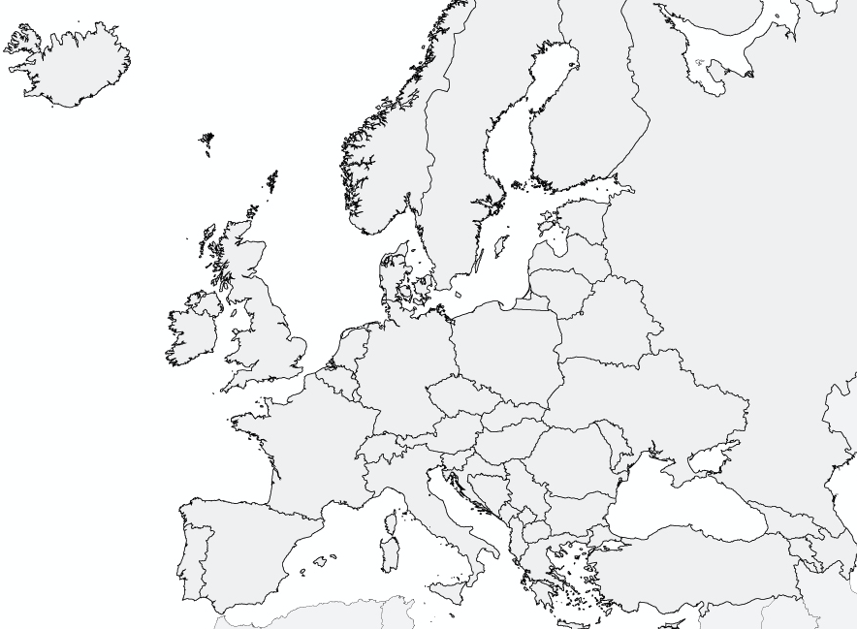

Slide 4

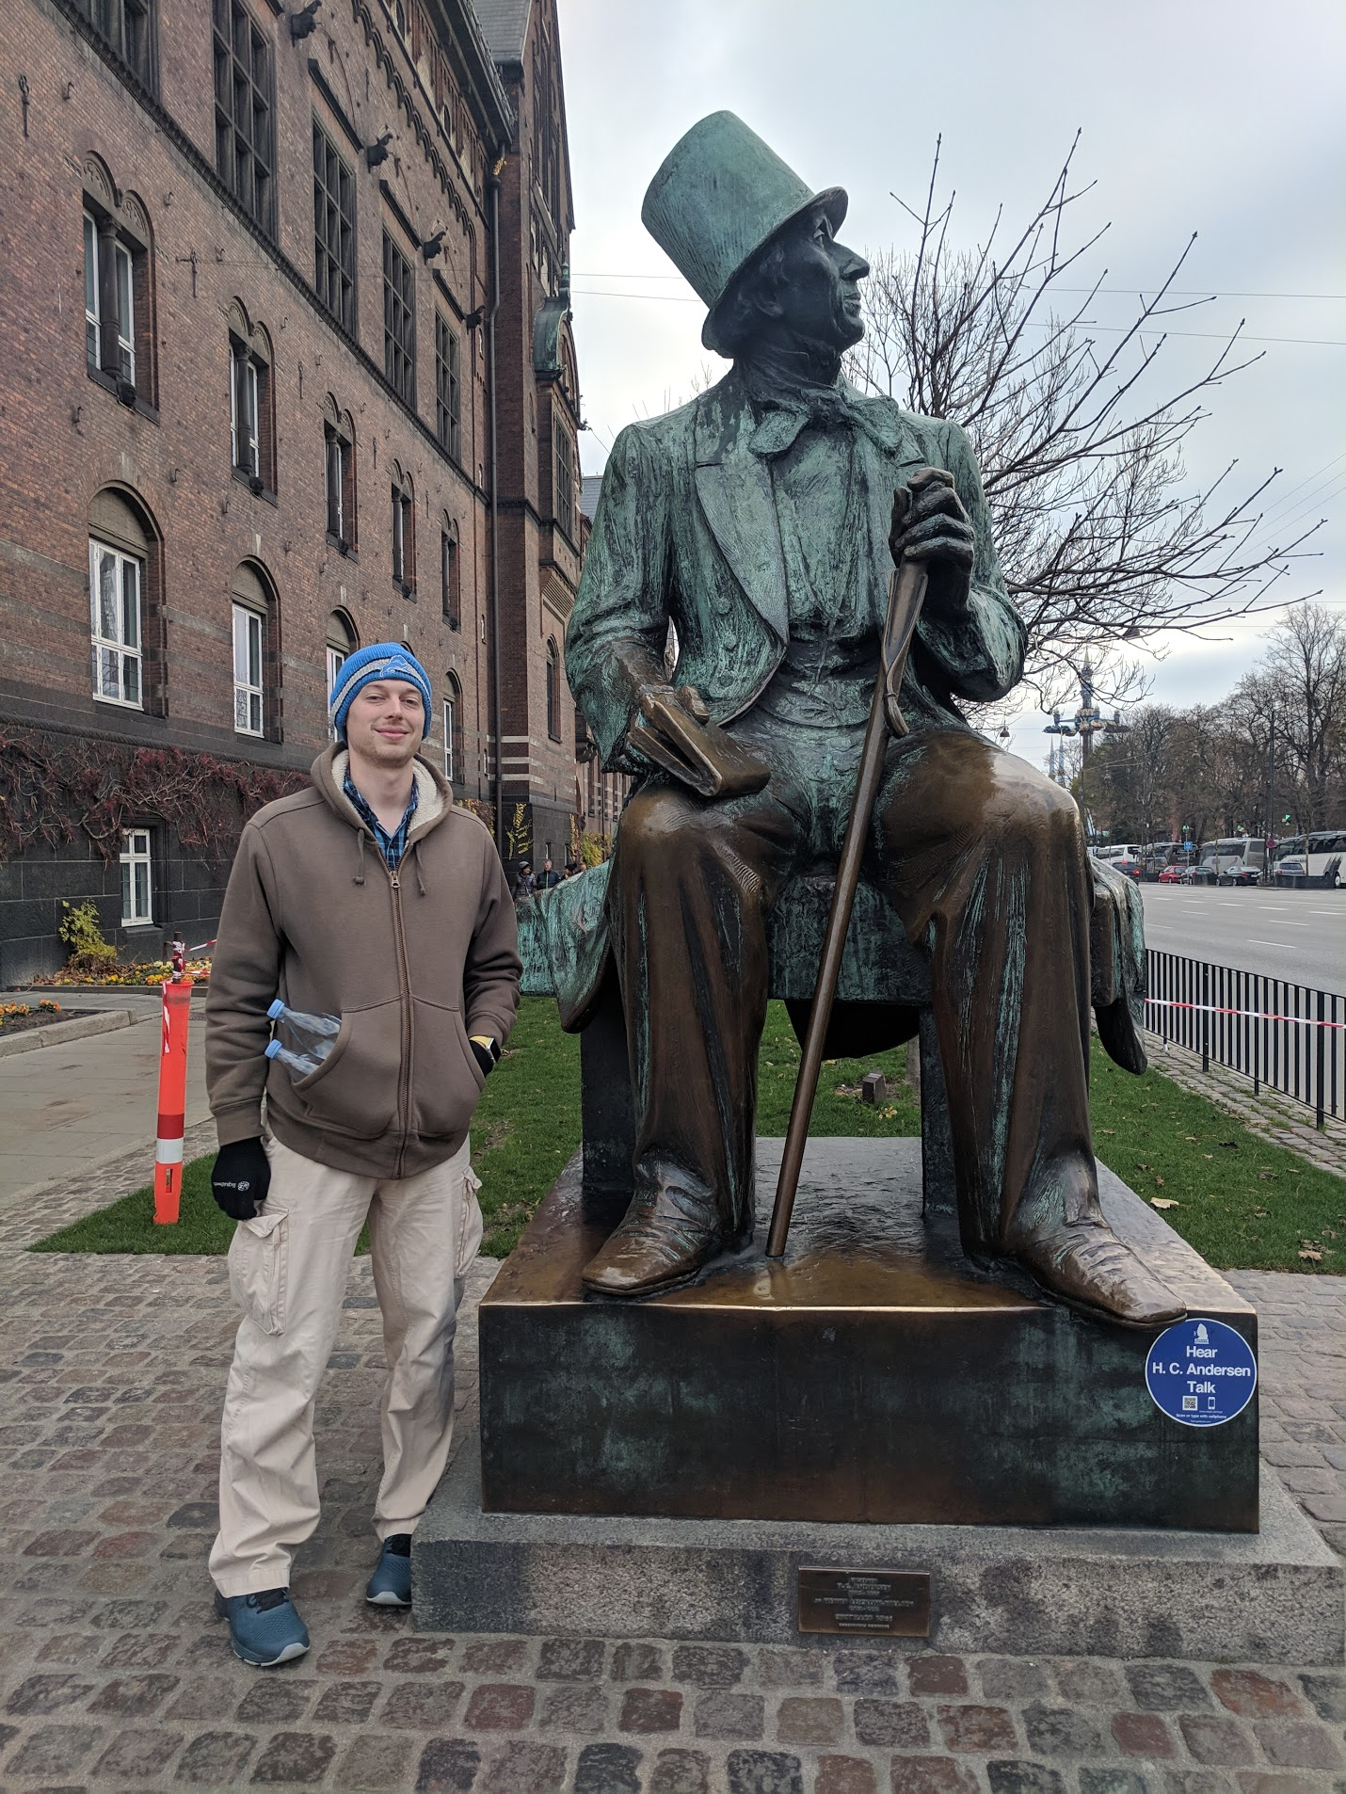



Slide 5
About Me
Developer Advocate at Progress
I was on the jQuery team
Level 40 Pokémon GO player
Once ate a whole large pizza by myself

Slide 6
TypeScript

Slide 7
TypeScript
Triple-Slash Directives
Declaration files
Namespaces
Structural detection
Classes
Compiler options
Type Inference
Modules
Generators
Declaration merging
Decorators
Generics
Mixins
Sequential piping
Symbols

Slide 8
TypeScript
Triple-Slash Directives
Declaration files
Namespaces
Structural detection
Classes
Compiler options
Type Inference
Modules
Generators
Declaration merging
Decorators
Generics
Mixins
Sequential piping
Symbols

Slide 9
Why I Was Wrong About TypeScript

Slide 10
Whether TypeScript is a good fit for your next project

Slide 11
Why I Was Wrong About TypeScript

Slide 12
“A typed superset of JavaScript that compiles to plain JavaScript”

Slide 13
“A typed superset of JavaScript that compiles to plain JavaScript”

Slide 14


Slide 15
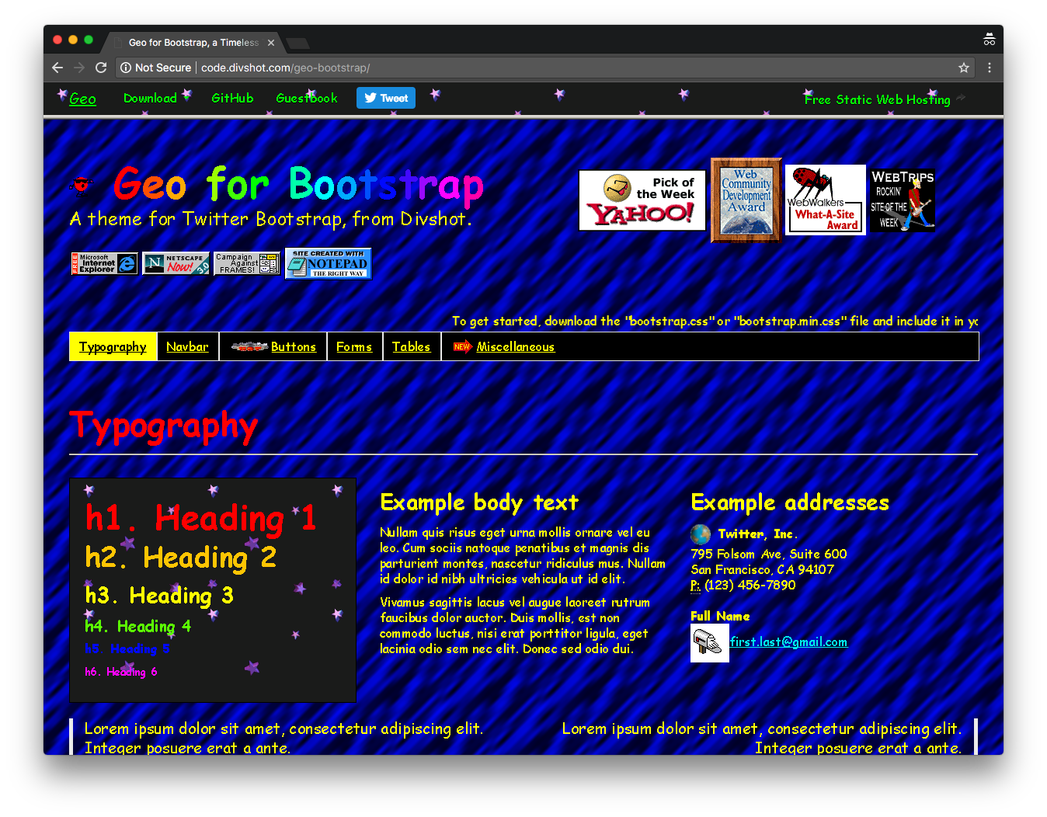

Slide 16
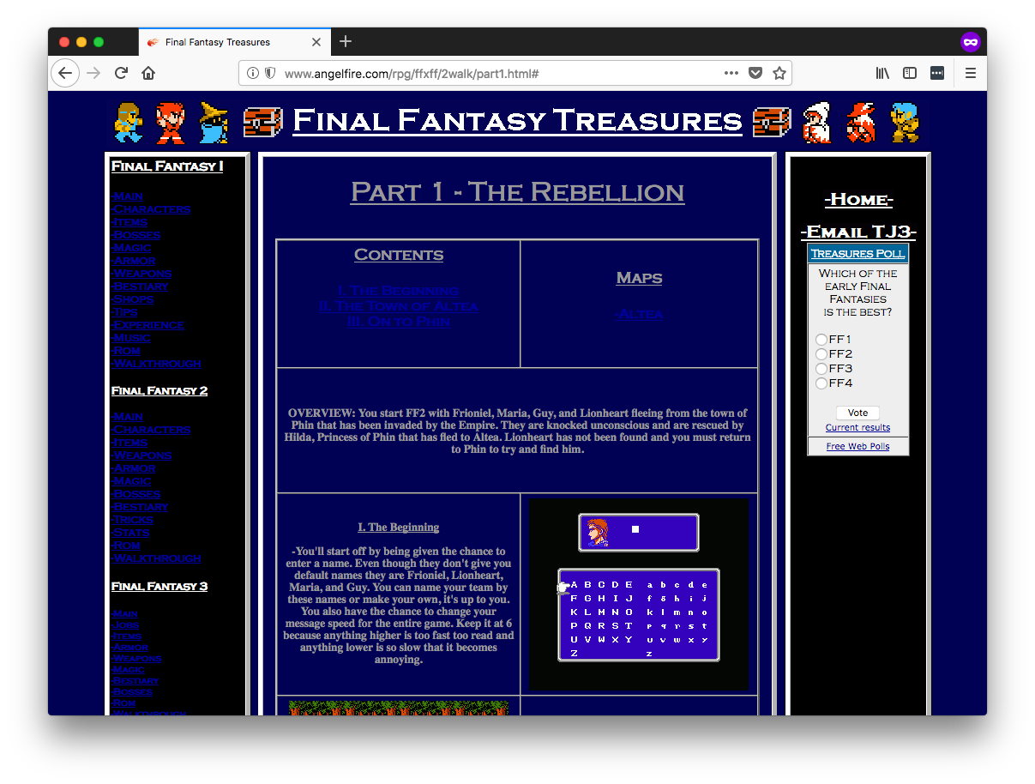
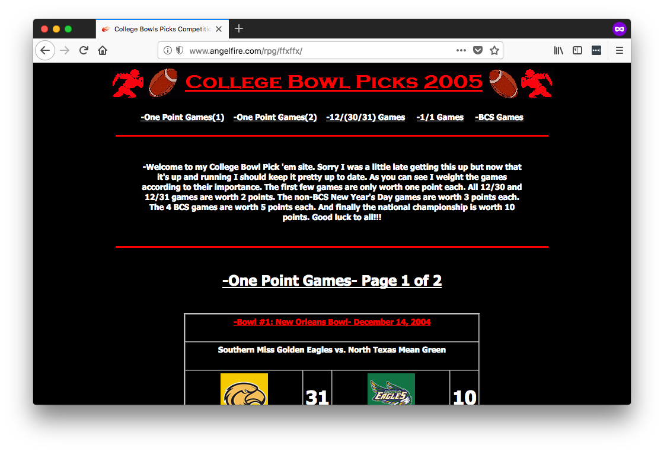
Actual web sites I built.

Slide 17
👨‍💼👩‍💼

Slide 18
😍

Slide 19
😠

Slide 20
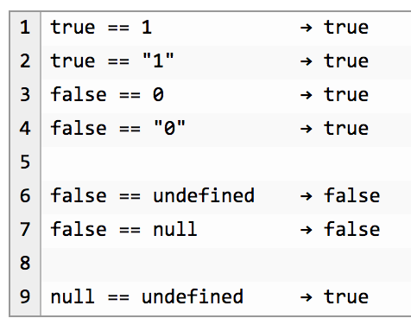

Slide 21
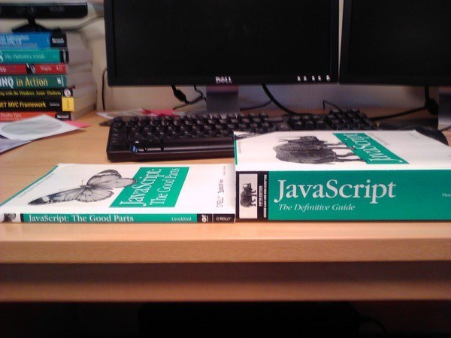
Notes:
34

Slide 22
Compile to JavaScript tools
There are a lot.
345
Source: https://github.com/jashkenas/coffeescript/wiki/List-of-languages-that-compile-to-JS
Ruby, Python, Erlang, Java, Scala, C#, F#, Lisp, Scheme, Haskell, Smalltalk, C, C++, Basic, Go, PHP, and way more.

Slide 23
Fun names of compile-to-JS tools
treehugger
jangaroo
Waterbear

Slide 24
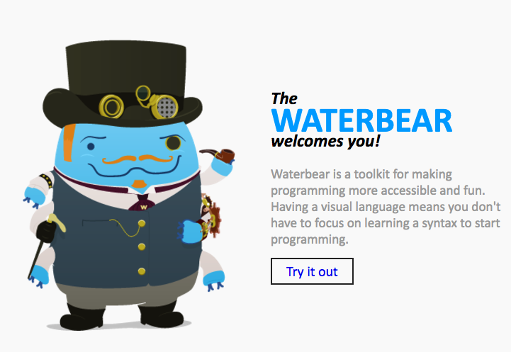
http://waterbearlang.com/

Slide 25
Compile to JavaScript tools
There are a lot.
345
Source: https://github.com/jashkenas/coffeescript/wiki/List-of-languages-that-compile-to-JS
Ruby, Python, Erlang, Java, Scala, C#, F#, Lisp, Scheme, Haskell, Smalltalk, C, C++, Basic, Go, PHP, and way more.

Slide 26
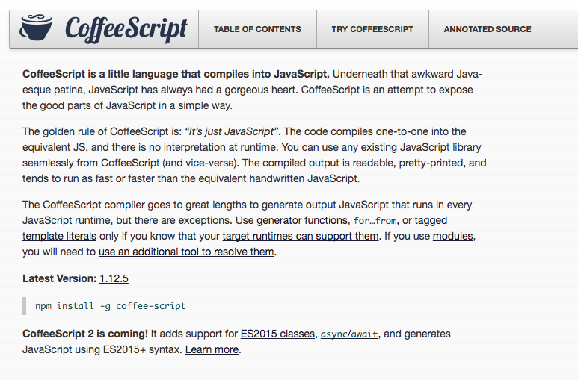
Notes:
2009

Slide 27
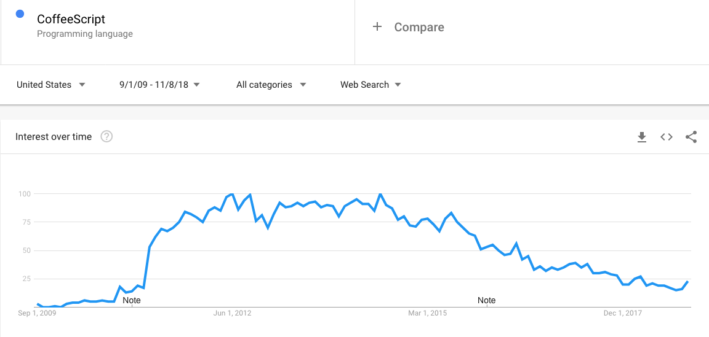

Slide 28
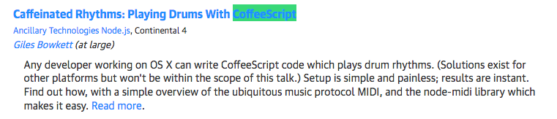
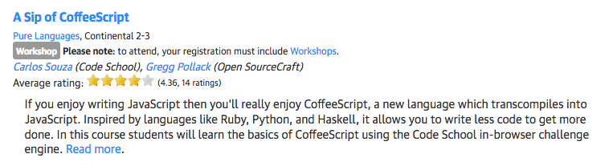
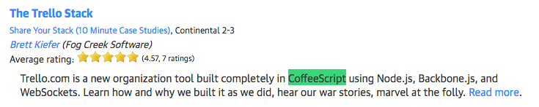
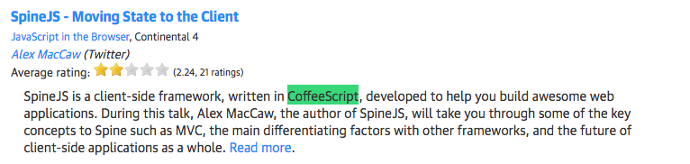

Slide 30
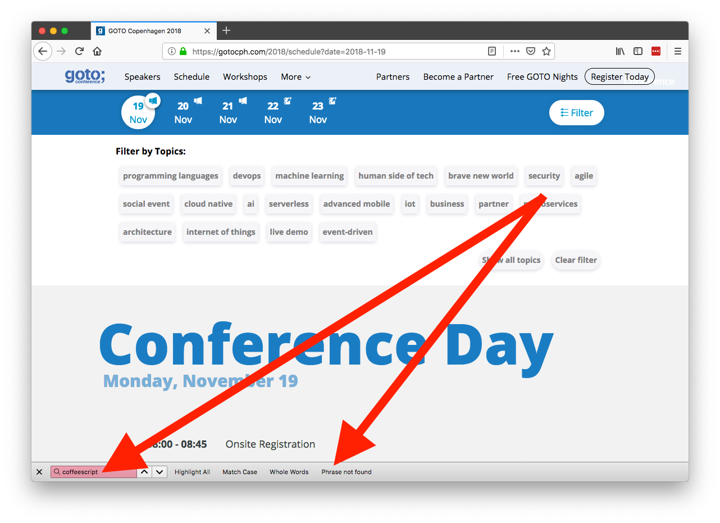

Slide 31
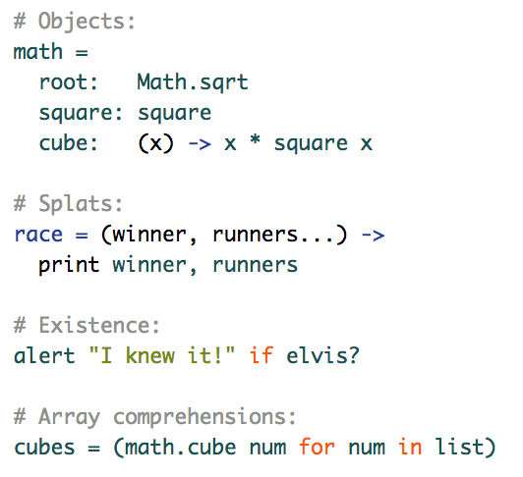

Slide 32
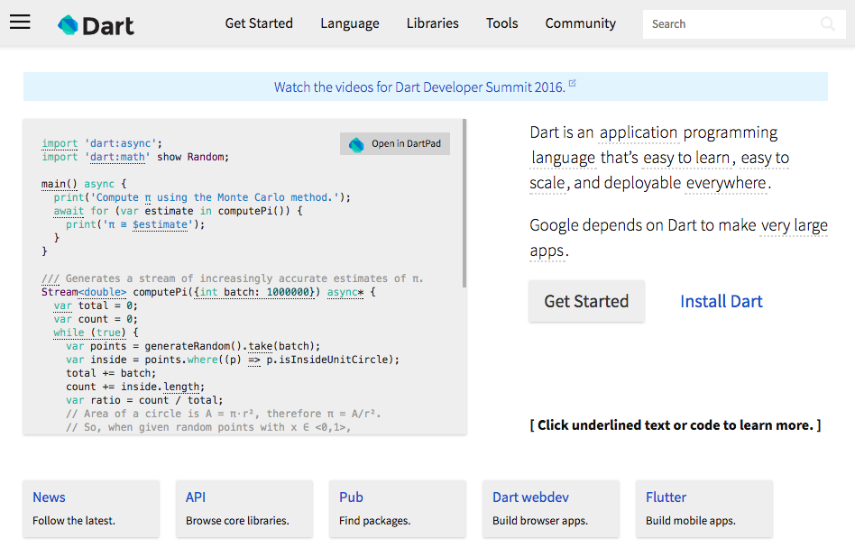
Notes:
2011

Slide 33
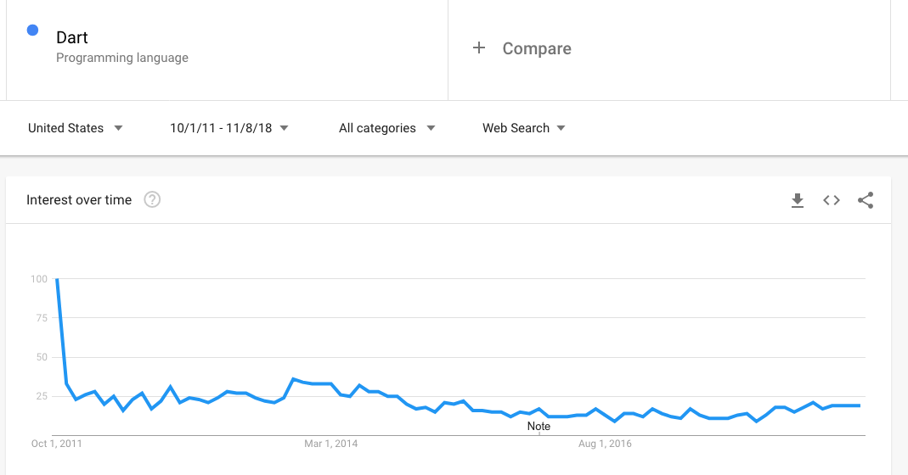

Slide 34
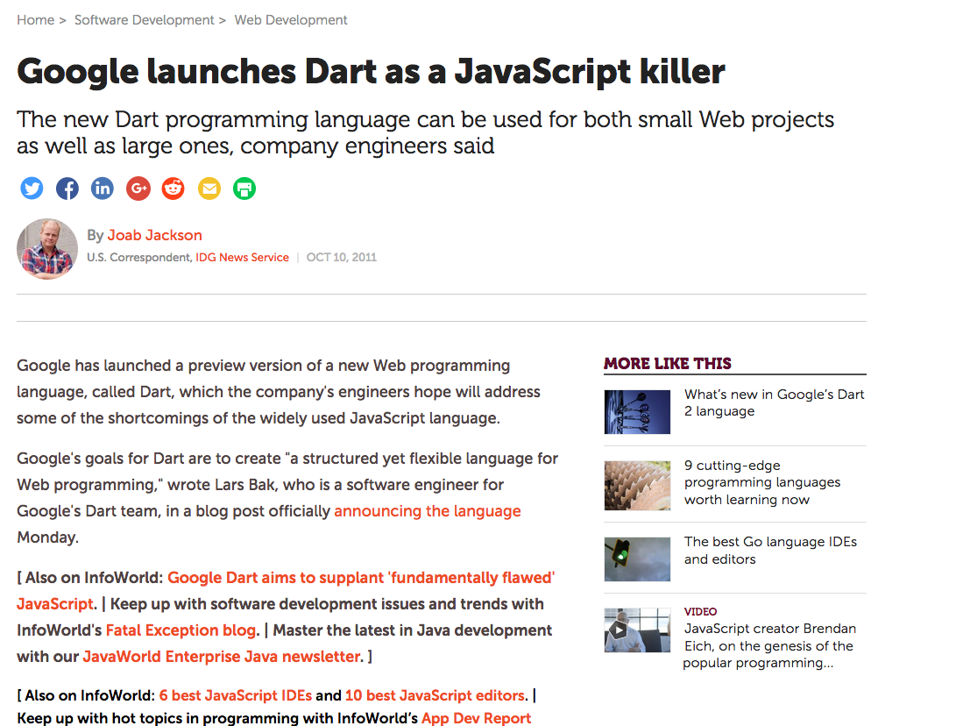

Slide 35
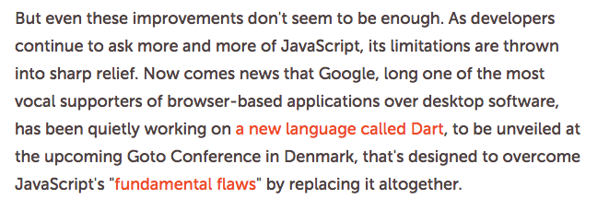

Slide 36
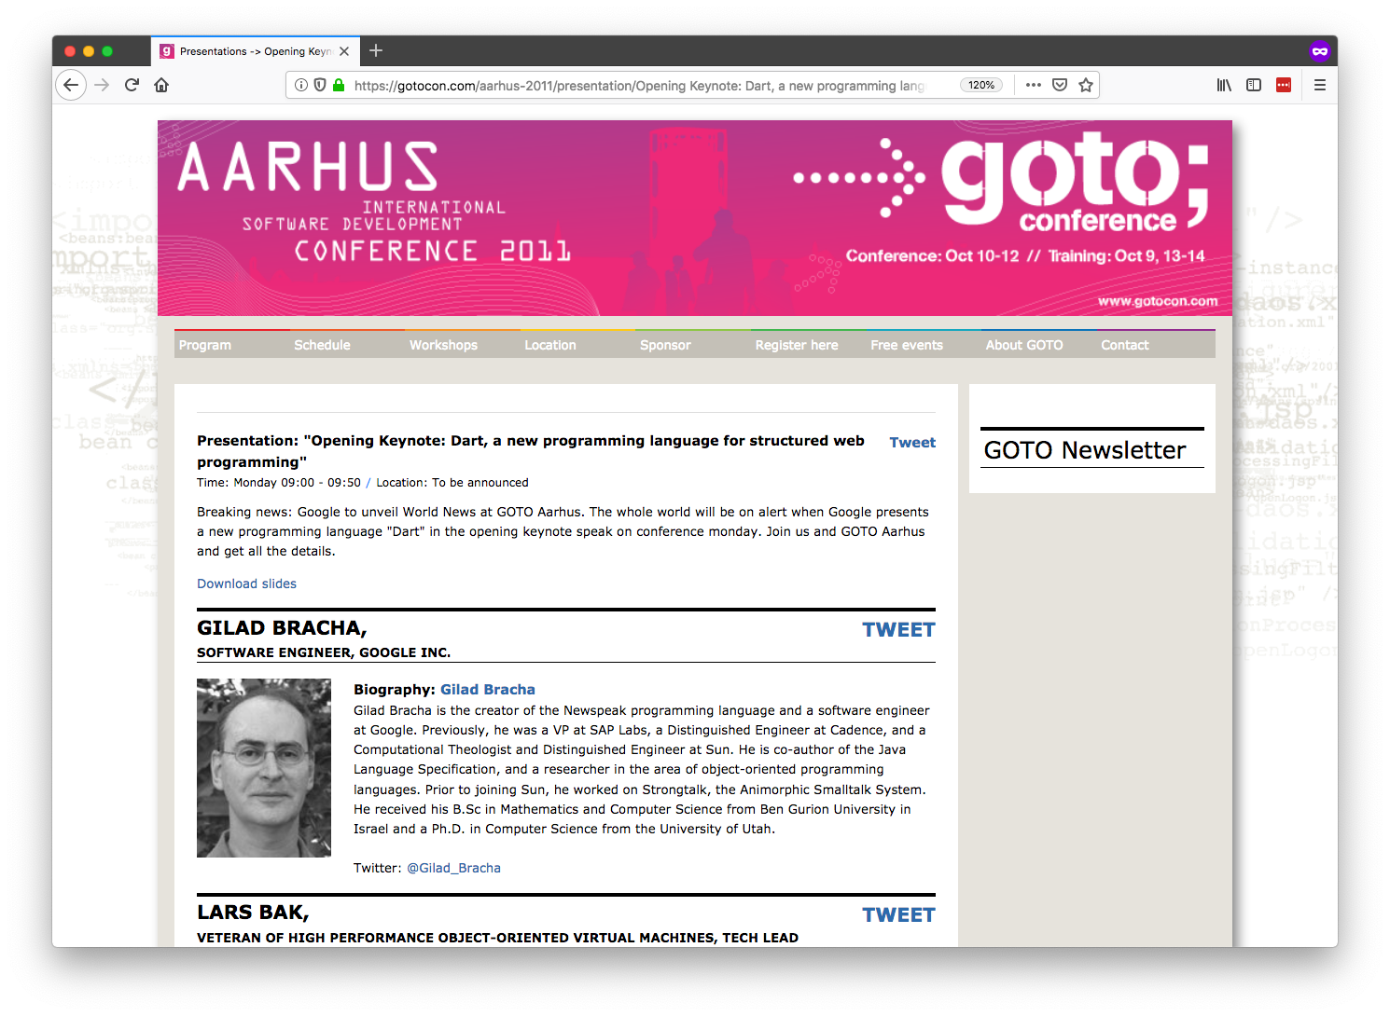

Slide 38
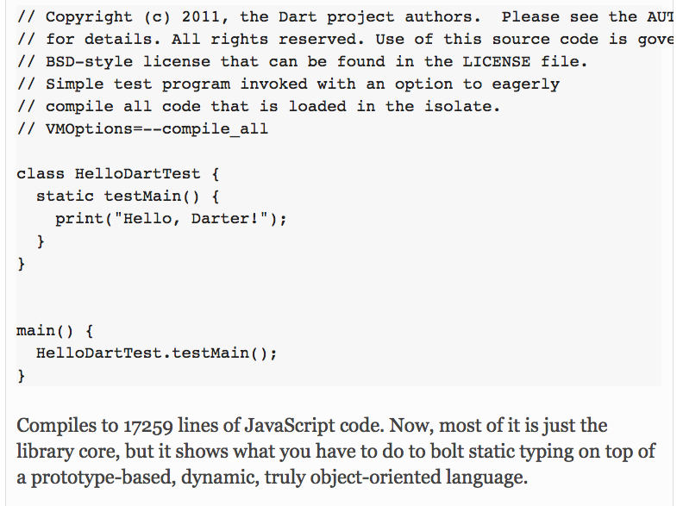

Slide 40


Slide 41
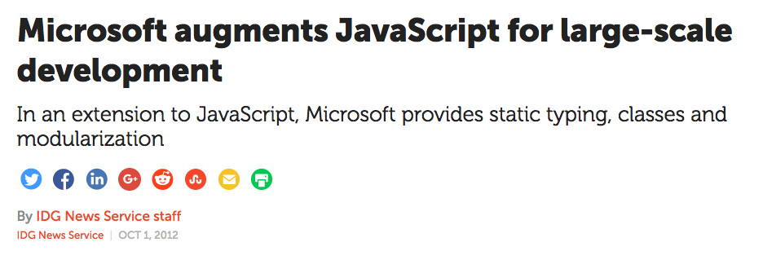
Notes:
October 2012

Slide 42
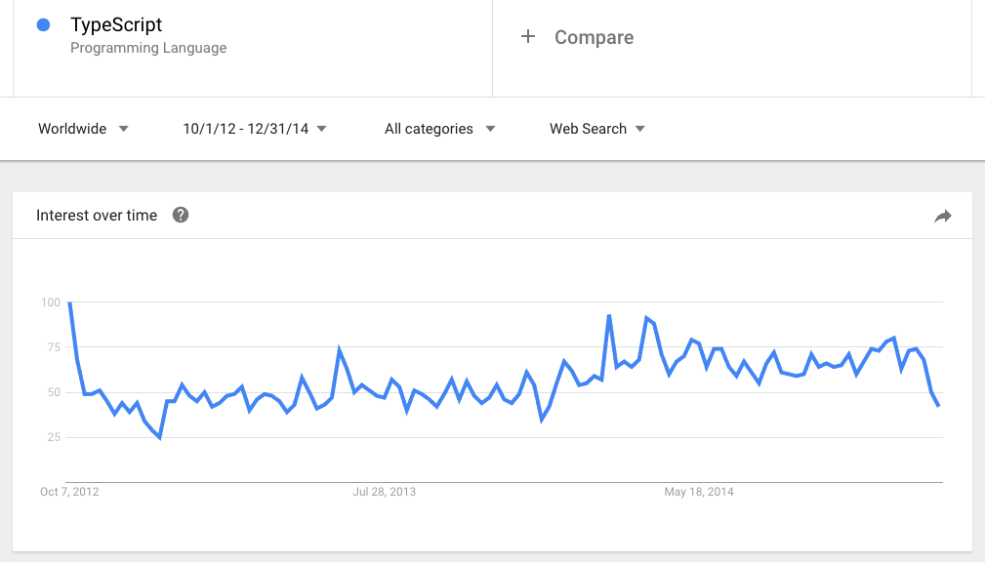

Slide 43
Why I Was Wrong About TypeScript

Slide 45


Slide 46
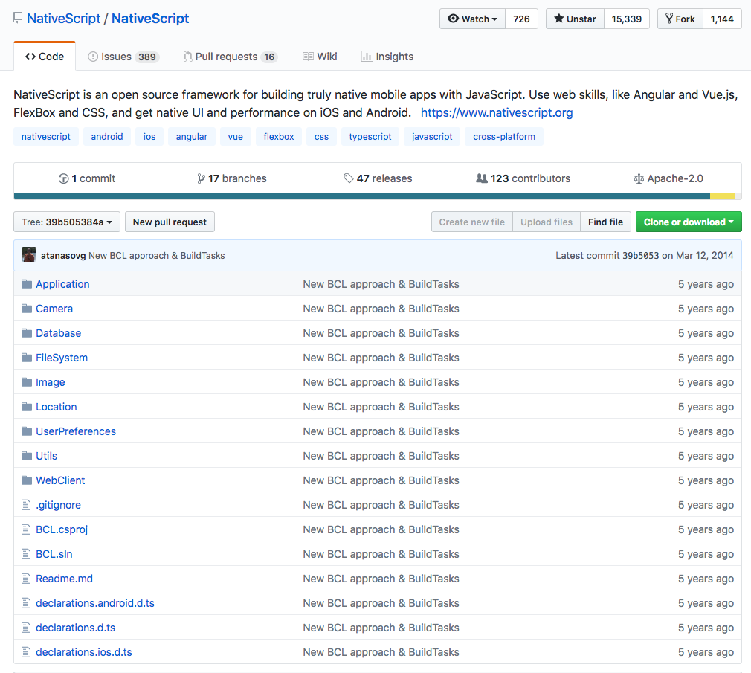

Slide 47

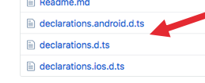

😱

Slide 49


Slide 50


Slide 51
✉️

Slide 52
“We risk a lot by building our core on top of TypeScript.”

Slide 53
“I don’t hear anyone talking about TypeScript.”

Slide 54
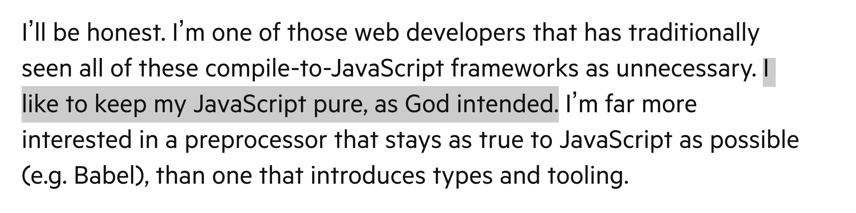

Slide 55
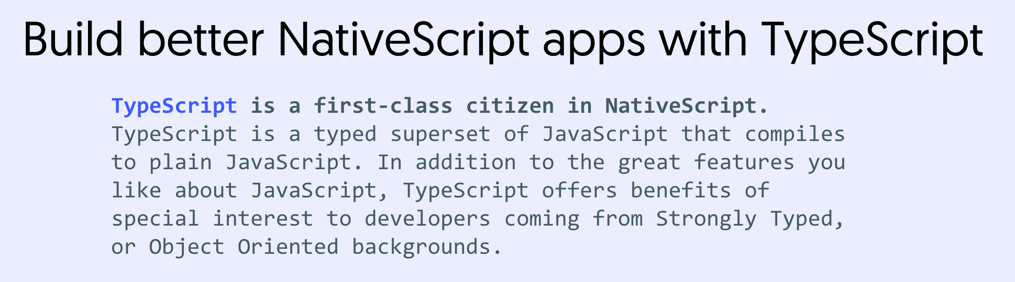

Slide 56
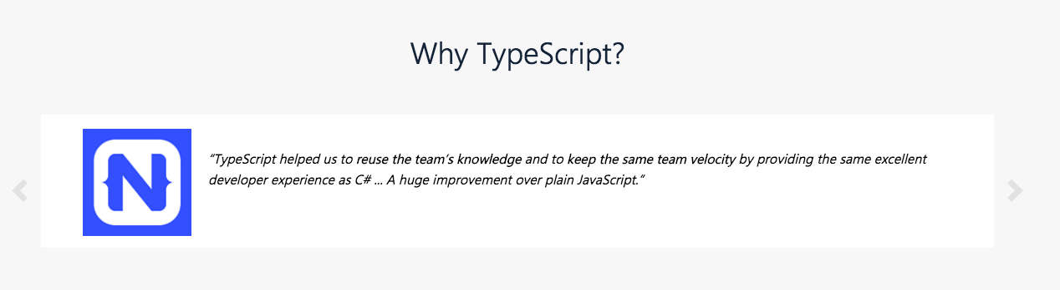

Slide 57
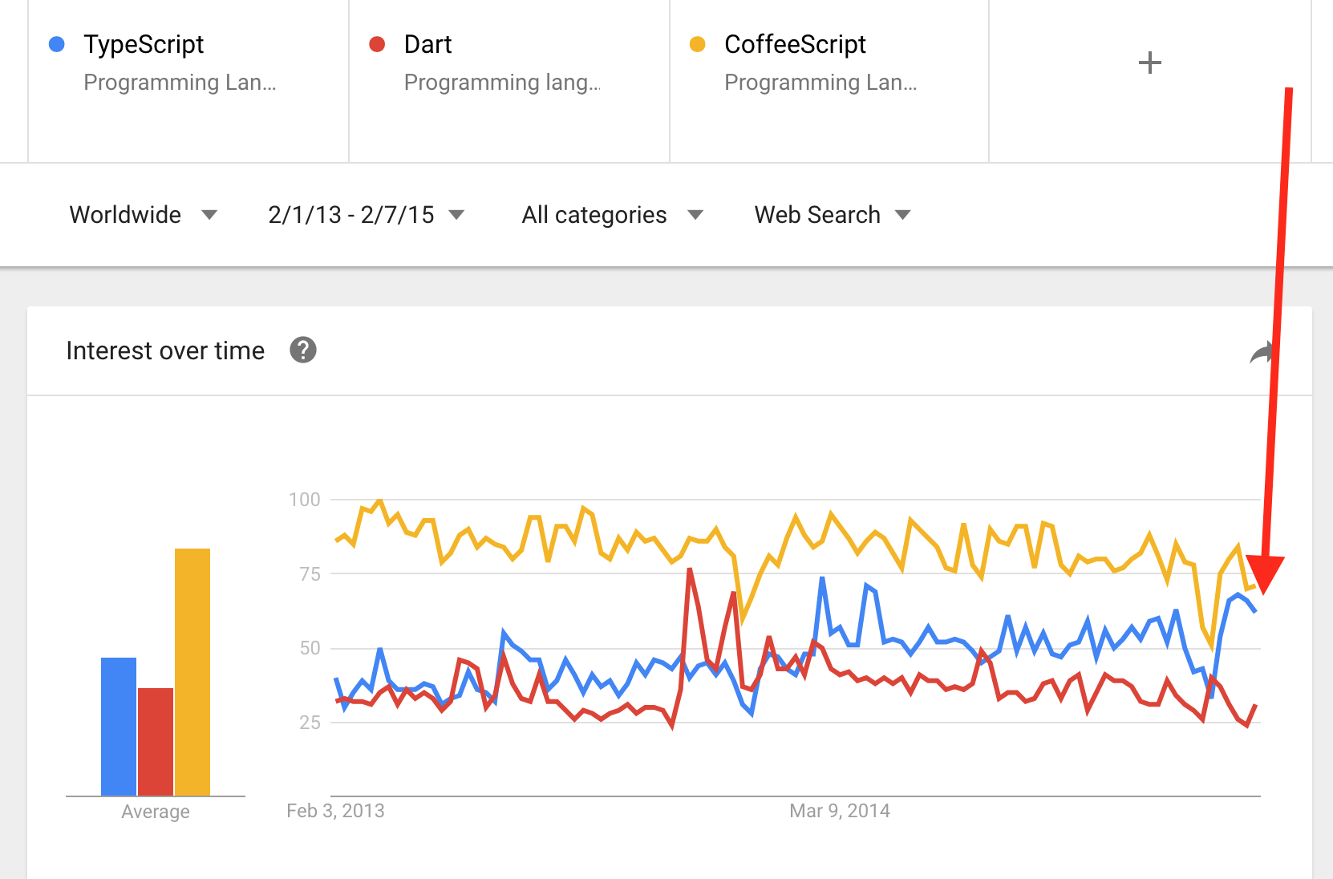

Slide 58
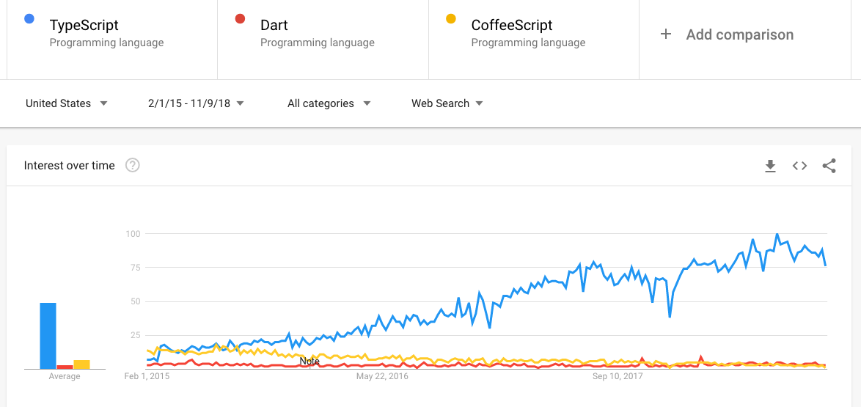

Slide 59
Why I Was Wrong About TypeScript

Slide 60
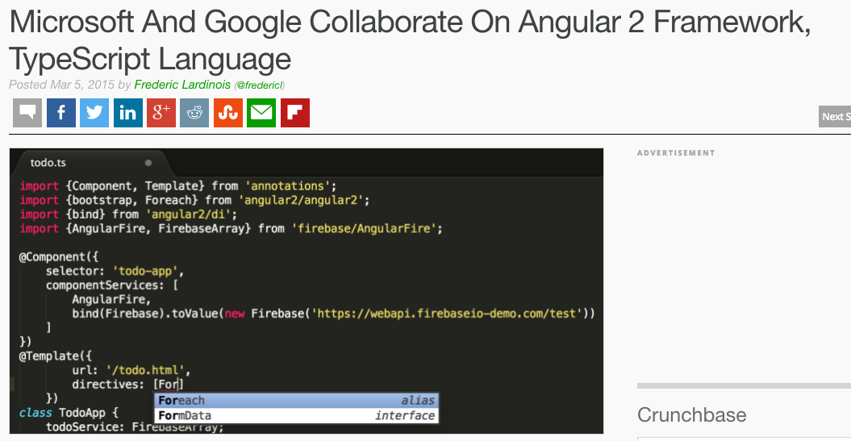

Slide 61
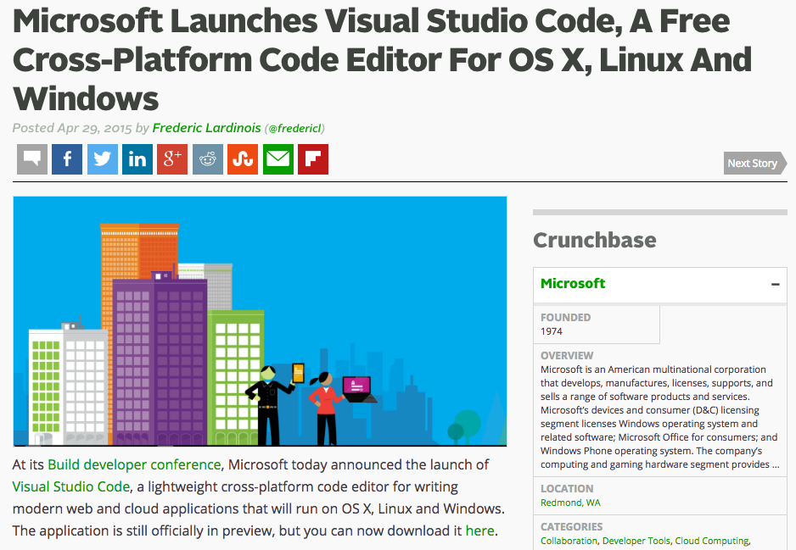

Slide 62
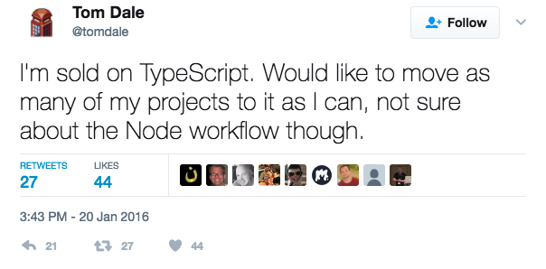

Slide 63
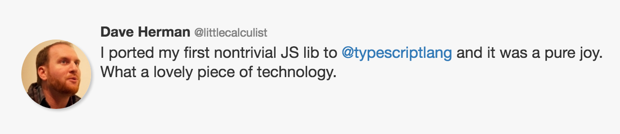

Slide 64
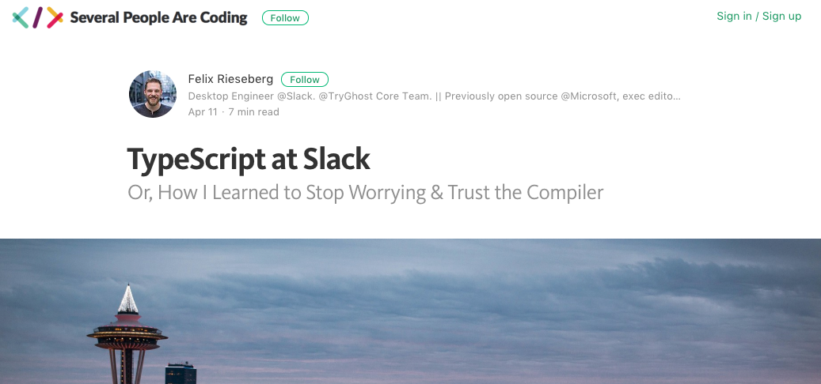

Slide 65
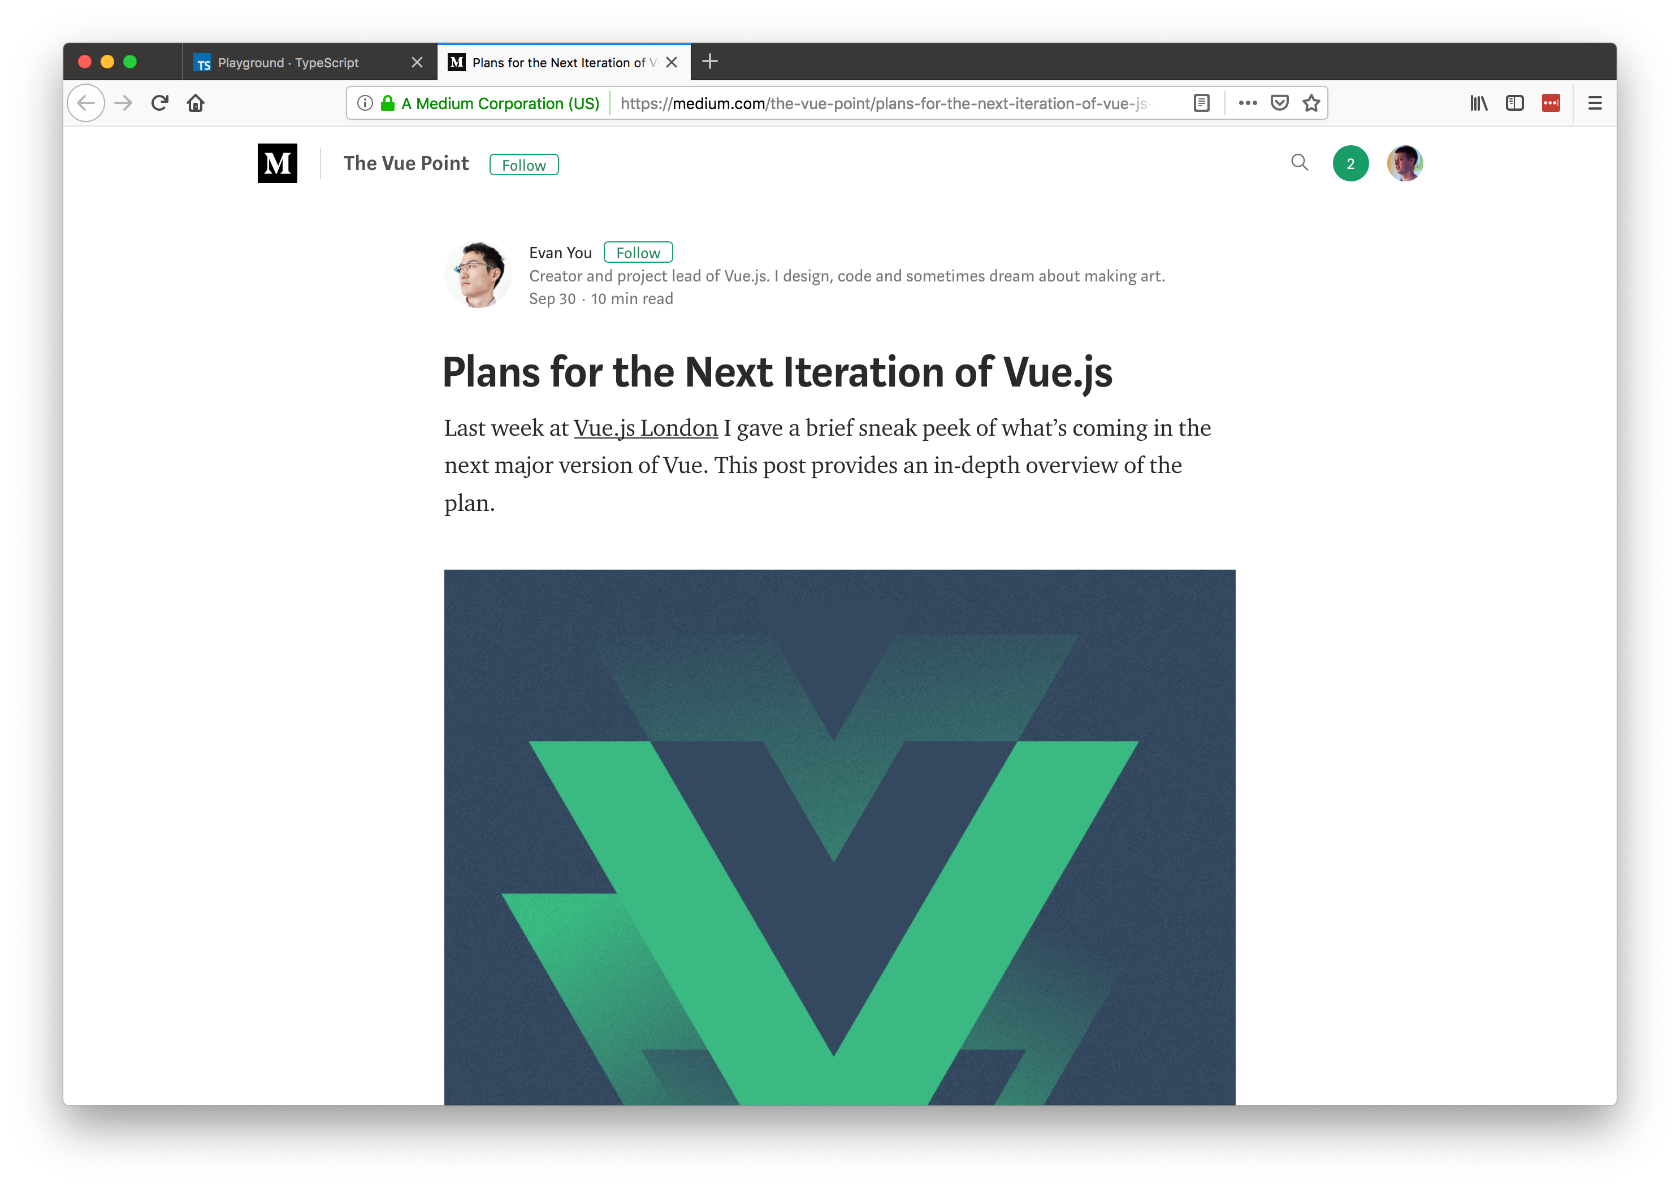
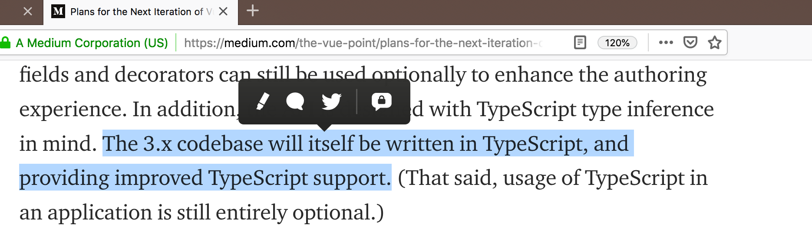

Slide 66
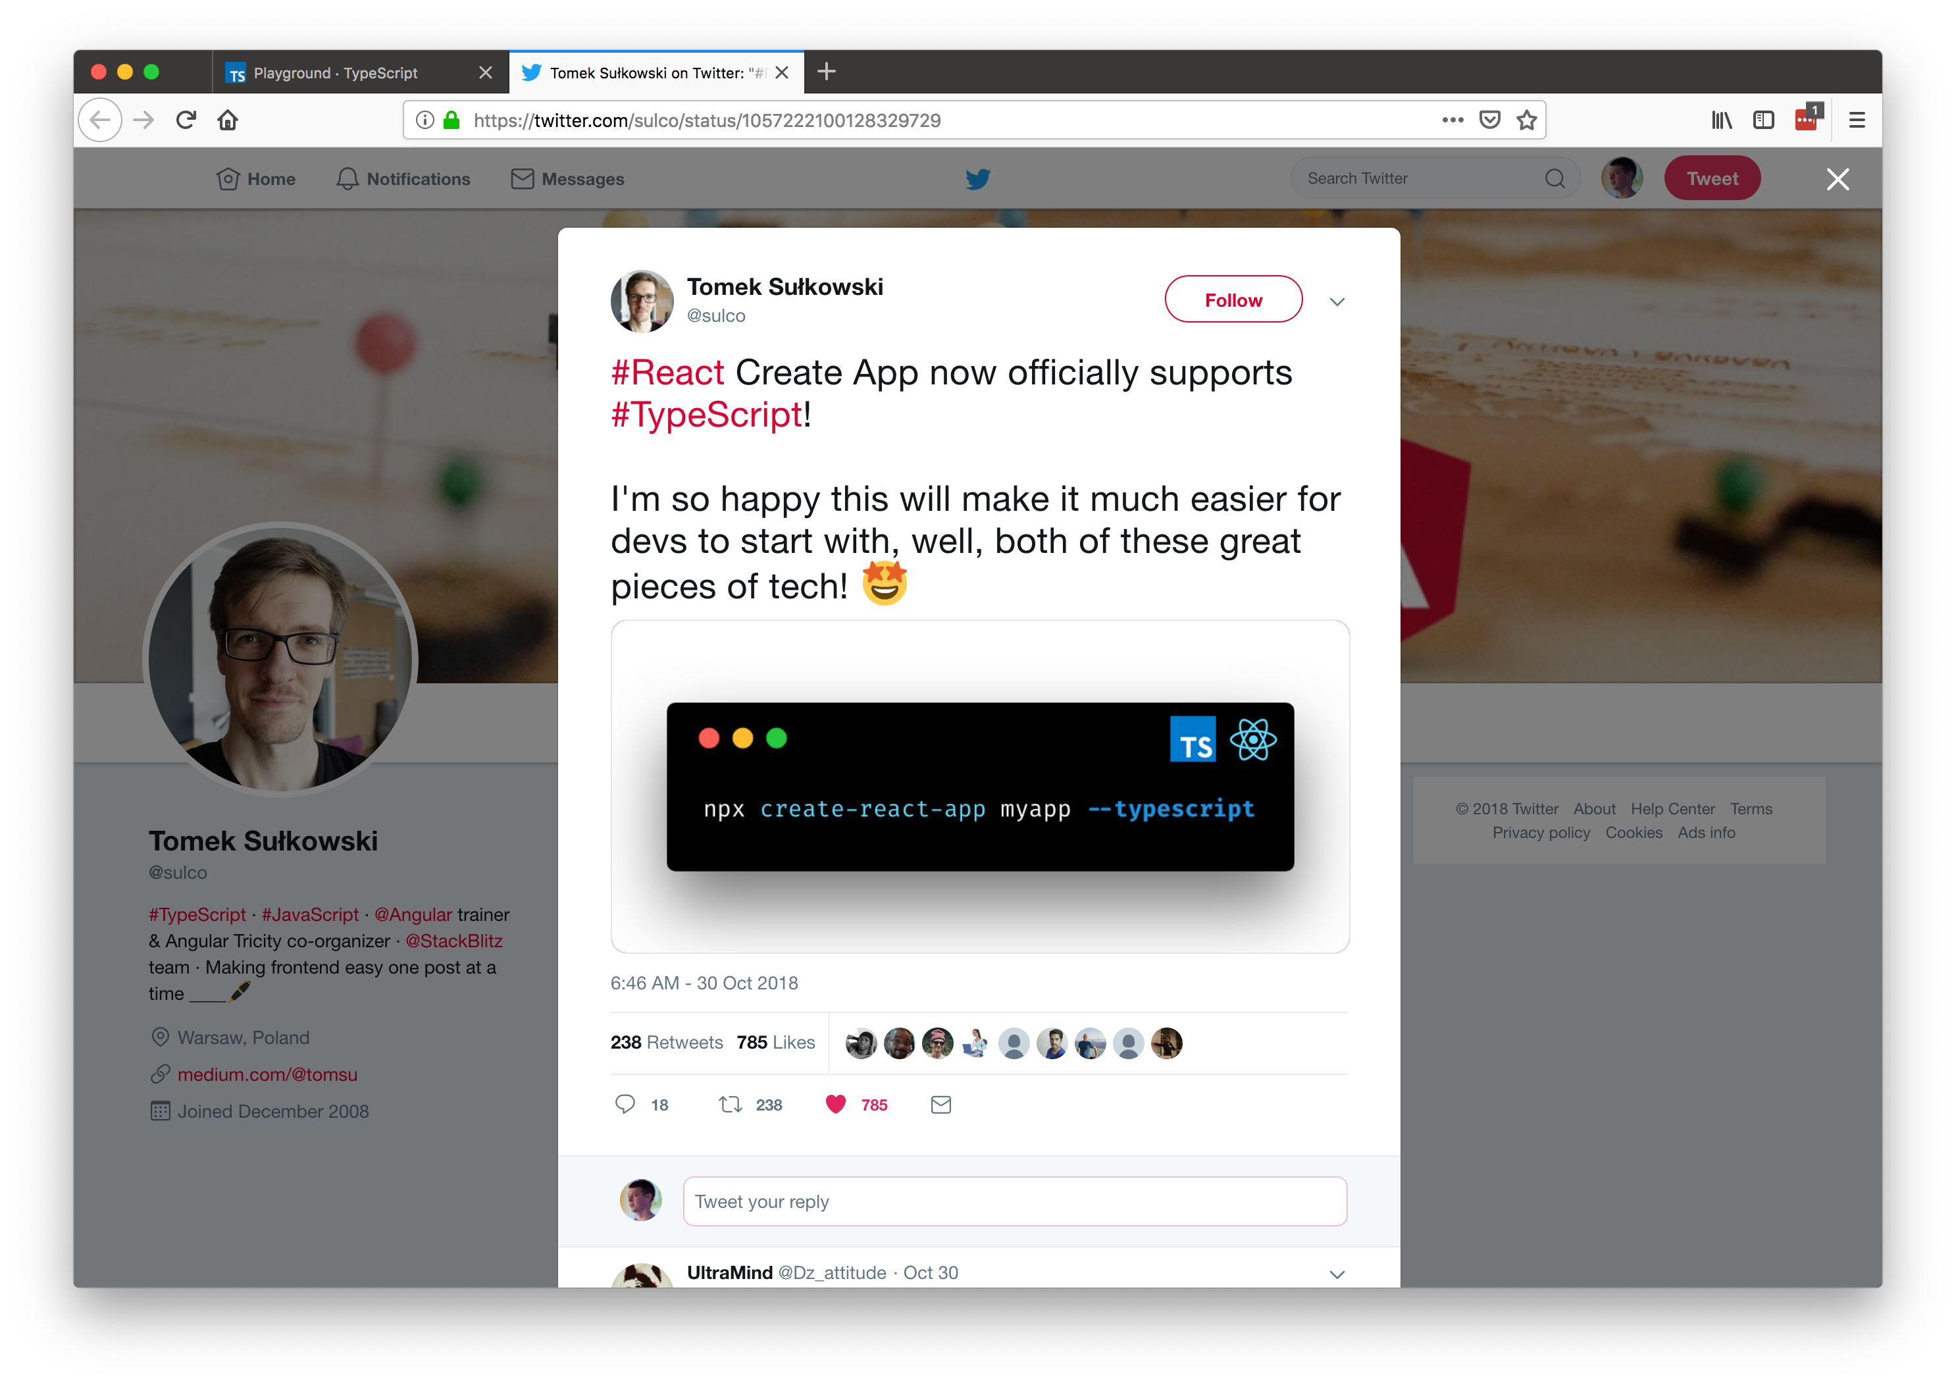

Slide 67
Why?

Slide 68


Developer Relations
Engineering
Marketing

Slide 69
3 reasons

Slide 70
1) Commitment to the ECMAScript standard

Slide 71
“Some examples [of compile-to-JavaScript frameworks], like Dart, portend that JavaScript has fundamental flaws and to support these scenarios requires a “clean break” from JavaScript in both syntax and runtime. We disagree with this point of view. We believe that with committee participant focus, the standards runtime can be expanded and the syntactic features necessary to support JavaScript at scale can be built upon the existing JavaScript standard.”

Slide 72
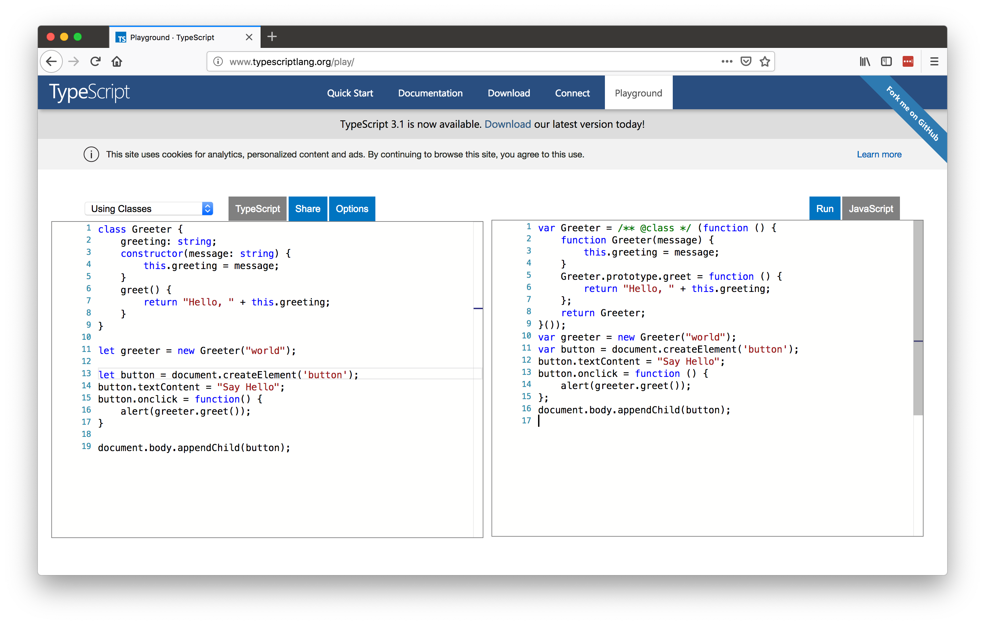

Slide 73
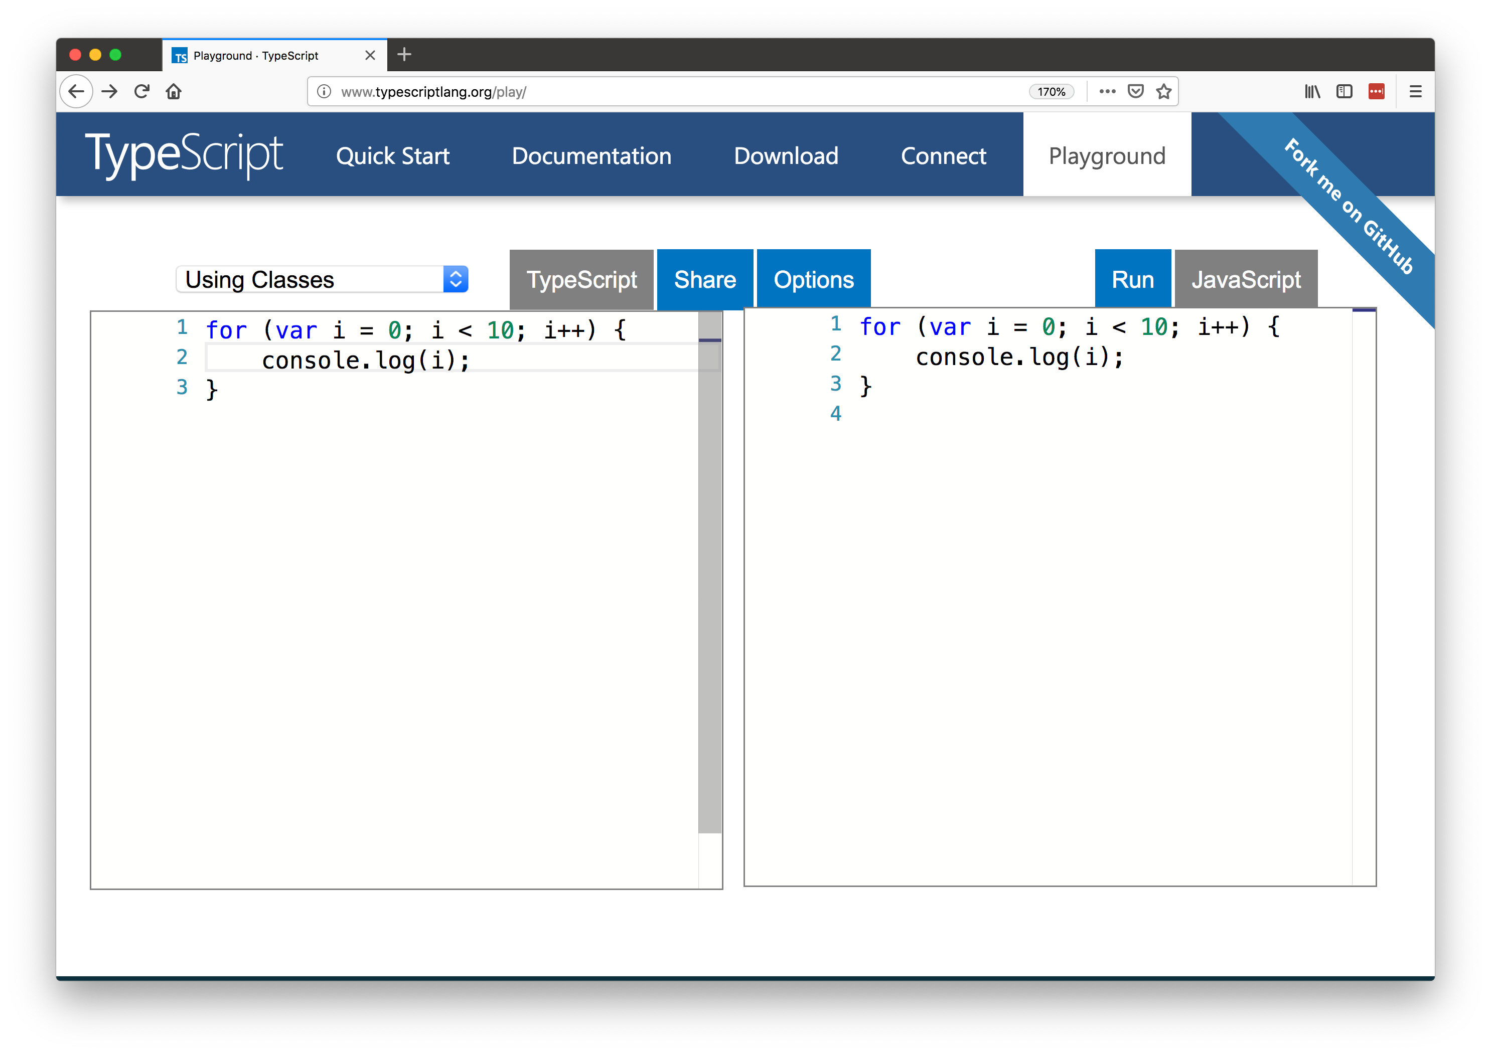

Slide 74
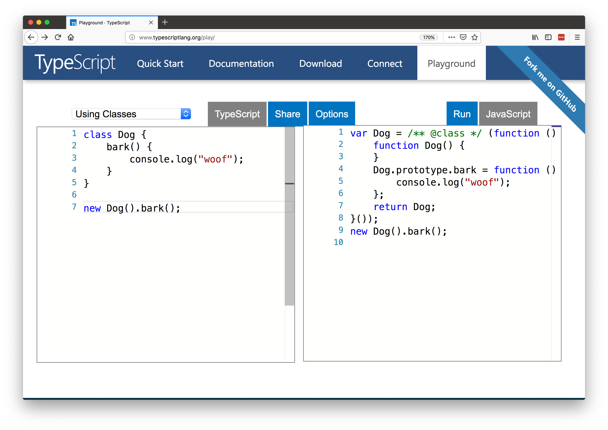

Slide 75
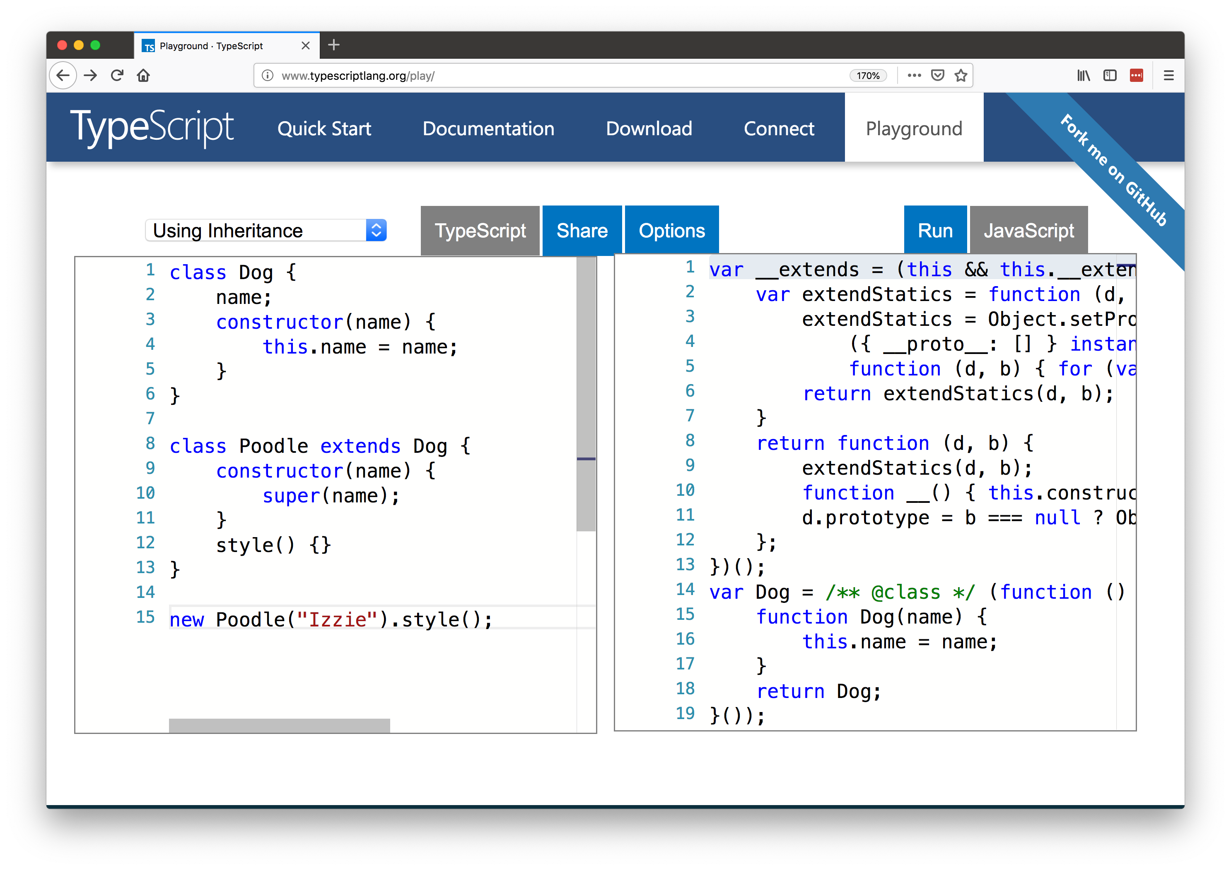

Slide 76
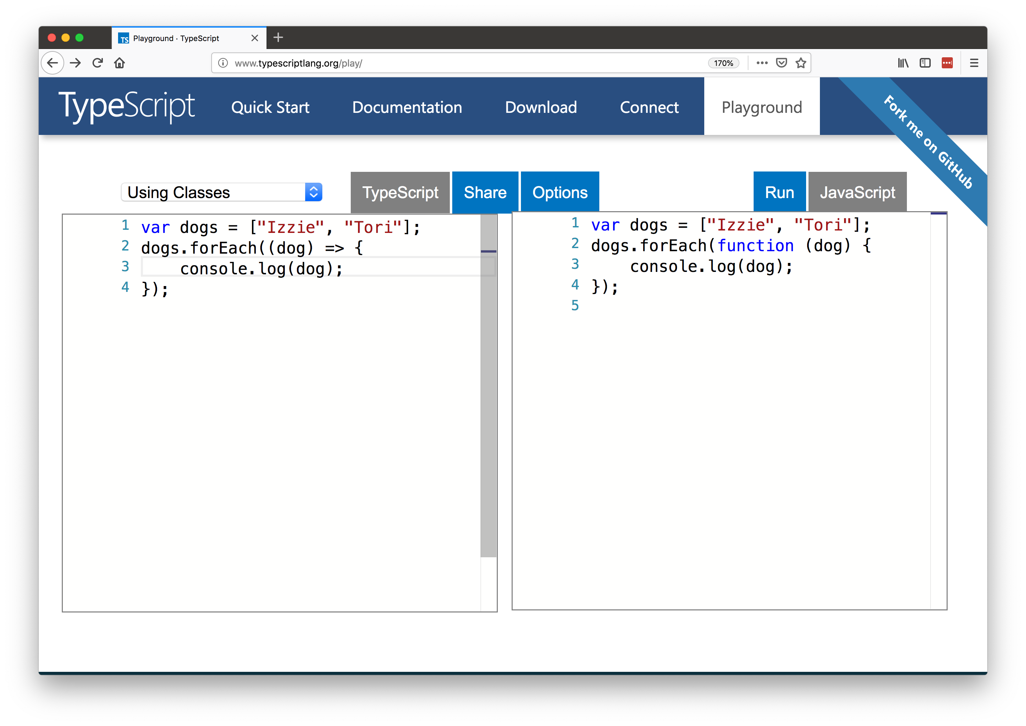

Slide 77
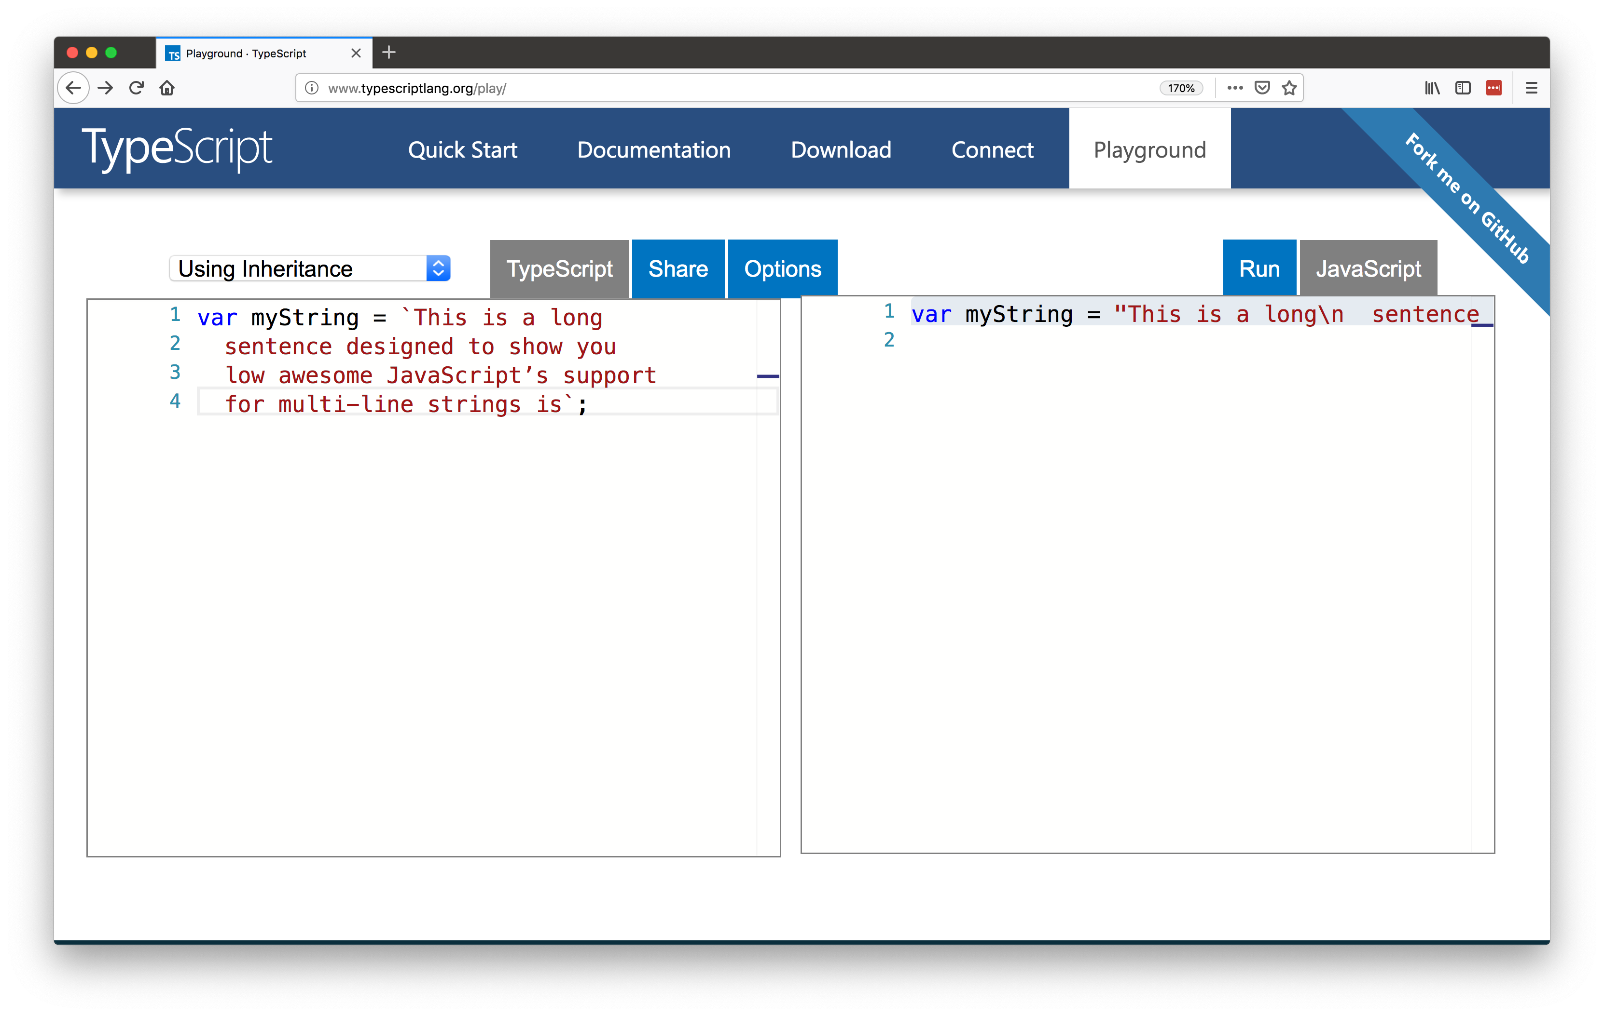

Slide 78
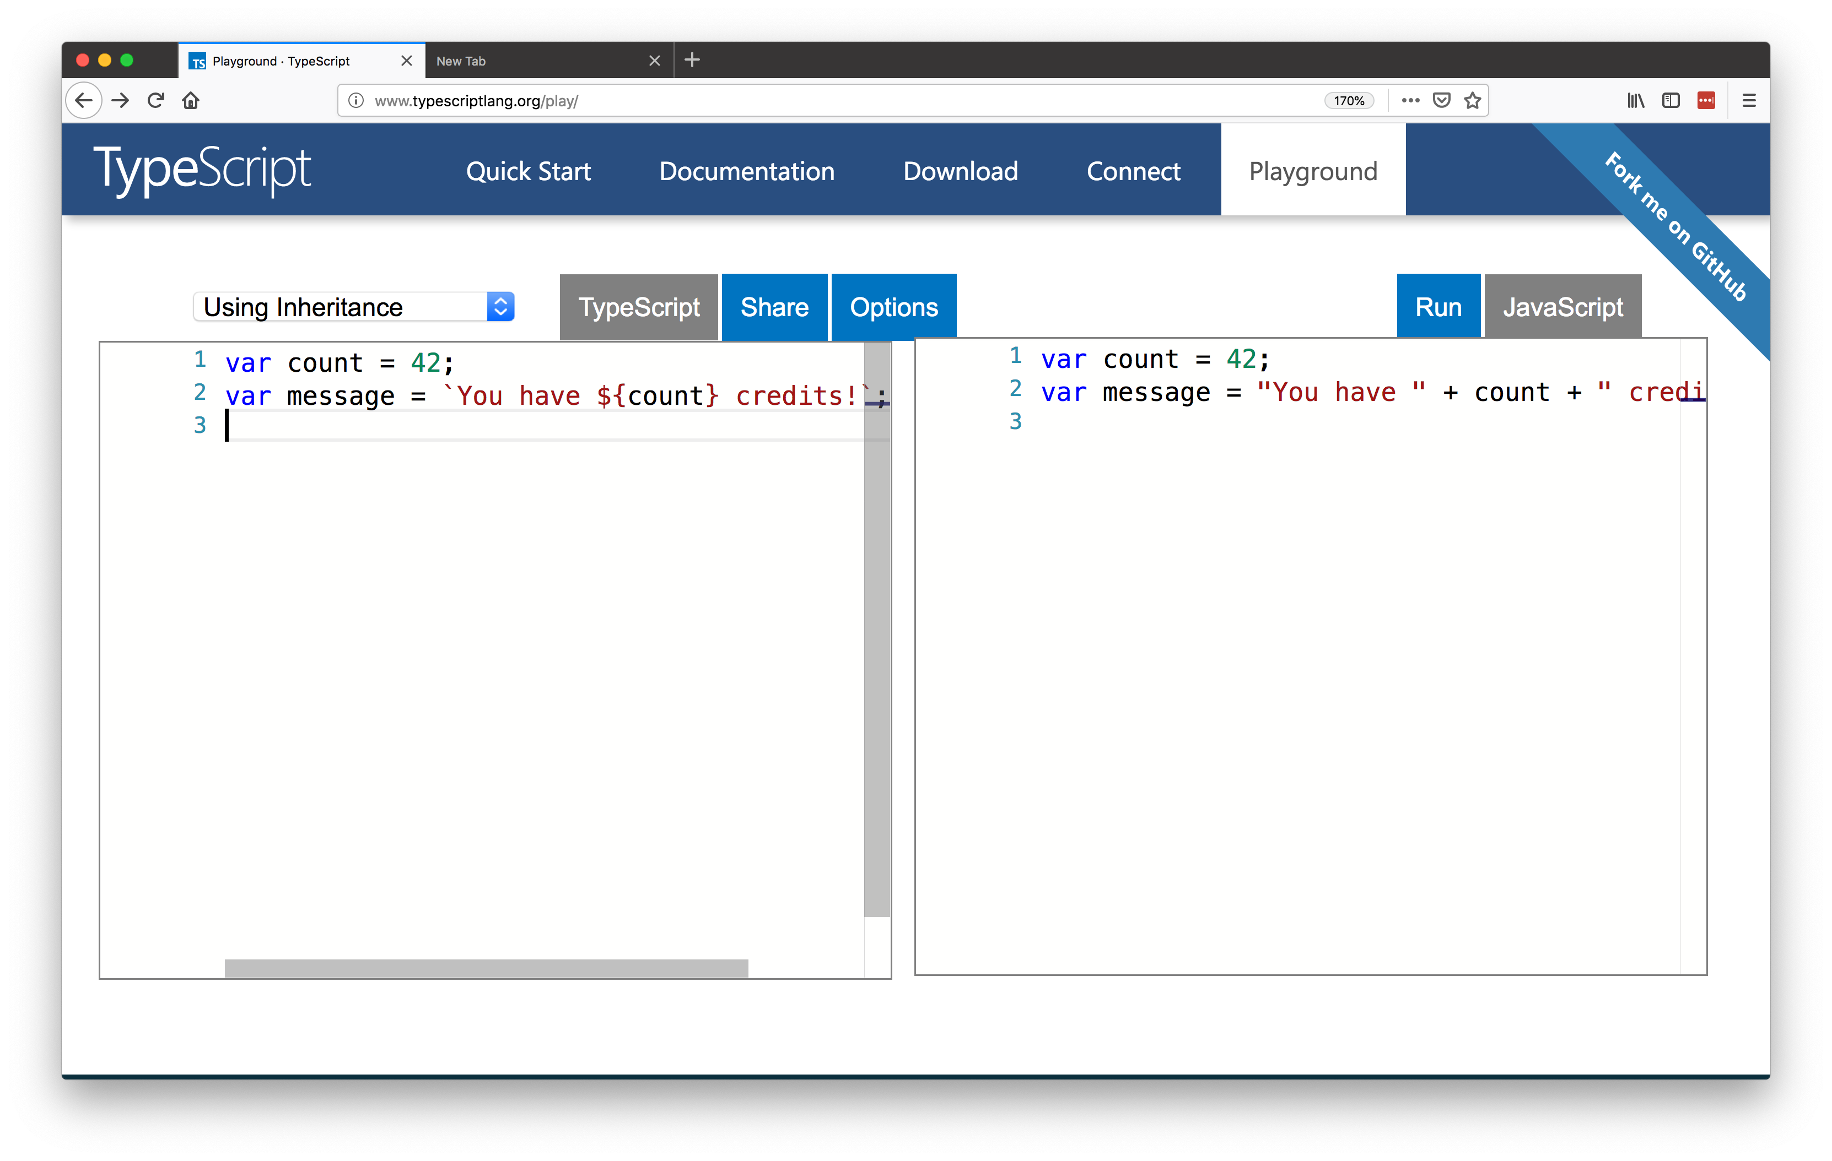

Slide 79
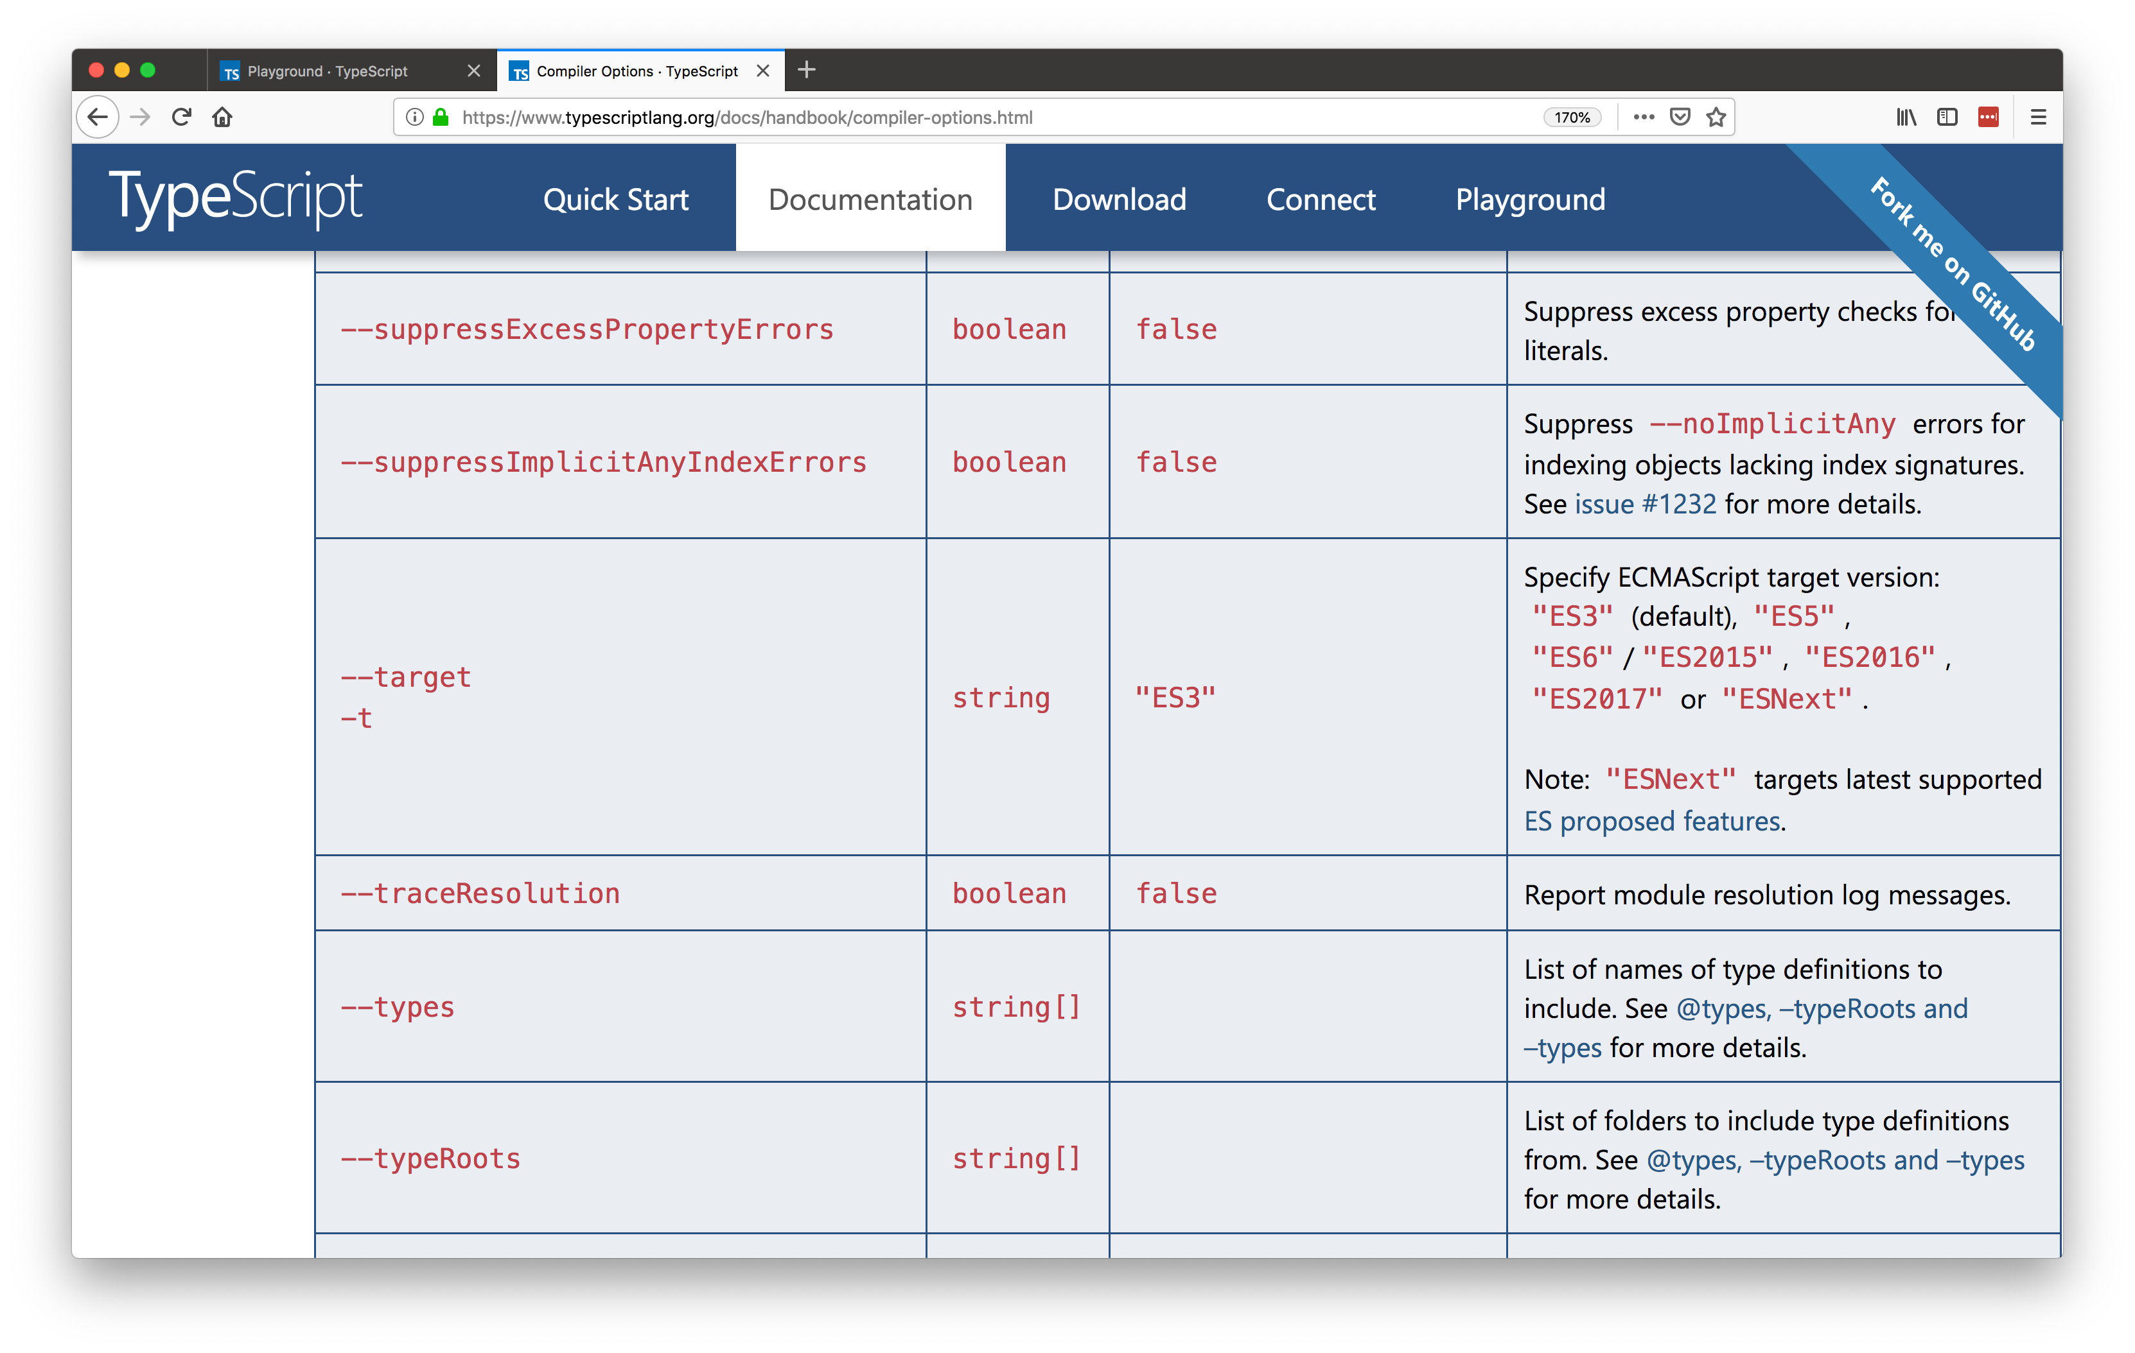

Slide 80
2) Types are opt-in

Slide 81
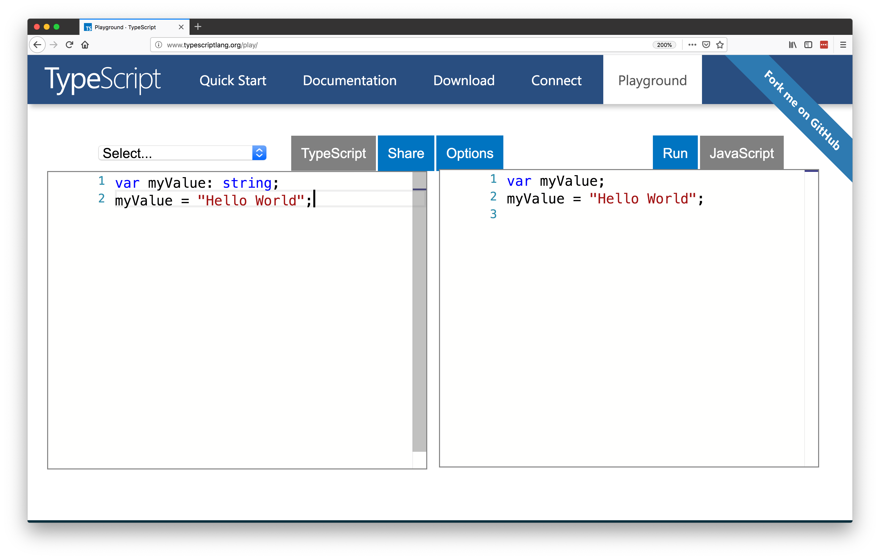

Slide 82


Slide 83
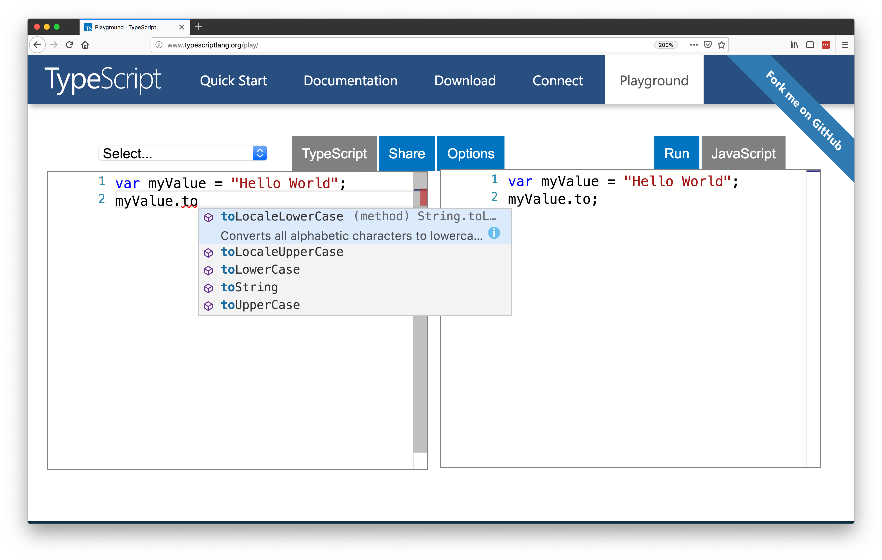

Slide 84
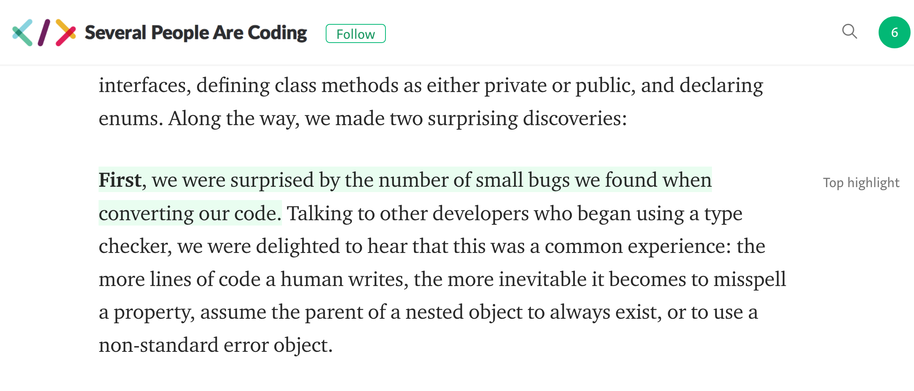

Slide 85
3) Tooling

Slide 86


Slide 87


Slide 88


Slide 89


Slide 90


Slide 91


Slide 92


Slide 93


Slide 94


Slide 95


Slide 96


Slide 97


Slide 98
Why I Was Wrong About TypeScript

Slide 99
Final quick topics
How to get started?
Is TypeScript similar to Flow?
What are the downsides to TypeScript?
Should you use TypeScript?

Slide 100
Final quick topics
How to get started?
Is TypeScript similar to Flow?
What are the downsides to TypeScript?
Should you use TypeScript?

Slide 101


Slide 102


Slide 103
Final quick topics
How to get started?
Is TypeScript similar to Flow?
What are the downsides to TypeScript?
Should you use TypeScript?

Slide 104


Slide 105
Final quick topics
How to get started?
Is TypeScript similar to Flow?
What are the downsides to TypeScript?
Should you use TypeScript?

Slide 106


Slide 107


Slide 108
Final quick topics
How to get started?
Is TypeScript similar to Flow?
What are the downsides to TypeScript?
Should you use TypeScript?
Notes:
It depends

Slide 109
So should you use TypeScript?
Are your apps big?
Do you work on a team?
Unfamiliar codebases?
Non JS developers that need to write JS code?

Slide 110


Slide 111


Slide 112
Thanks!
@tjvantoll

